Slide 1
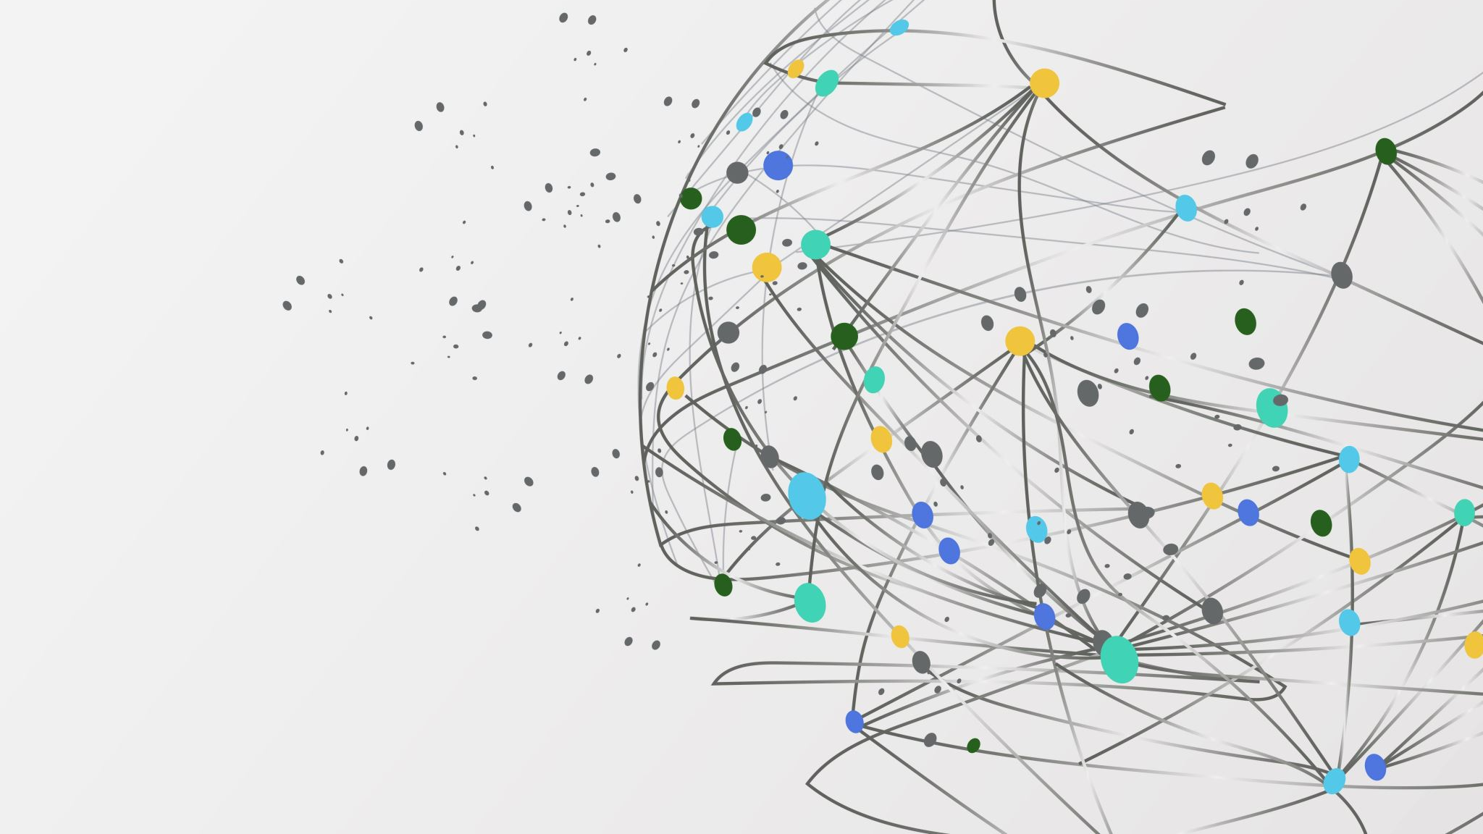

ILLUMINAT3D
NASA’S SPACE APPS CHALLENGE
2021|THESSALONIKI

Slide 2



Our Team
Our Solution
Maria Doli|Department of Physics, AUTh
Manolis Eleftheriadis|Department of Informatics, AUTh
Dimitris Komitis|Department of Physics, AUTh
Ioannis Liodis|Department of Physics, AUTh
Konstadina Noula|Department of Physics, AUTh
Eirini Rodiou|Department of Physics, AUTh
Educative GUI.
Innovative app based on the mathematical analysis of 3D models.
Intuitive approach constructed from scratch.
ILLUMINAT3D
The Challenge
The user can adjust five different parameters.
Producing the light curves of any 3D object inserted (in stl format).
WHEN LIGHT CURVES THROW US CURVE BALLS
Does not require 3D representation, no need for graphical processing cores.

Slide 3

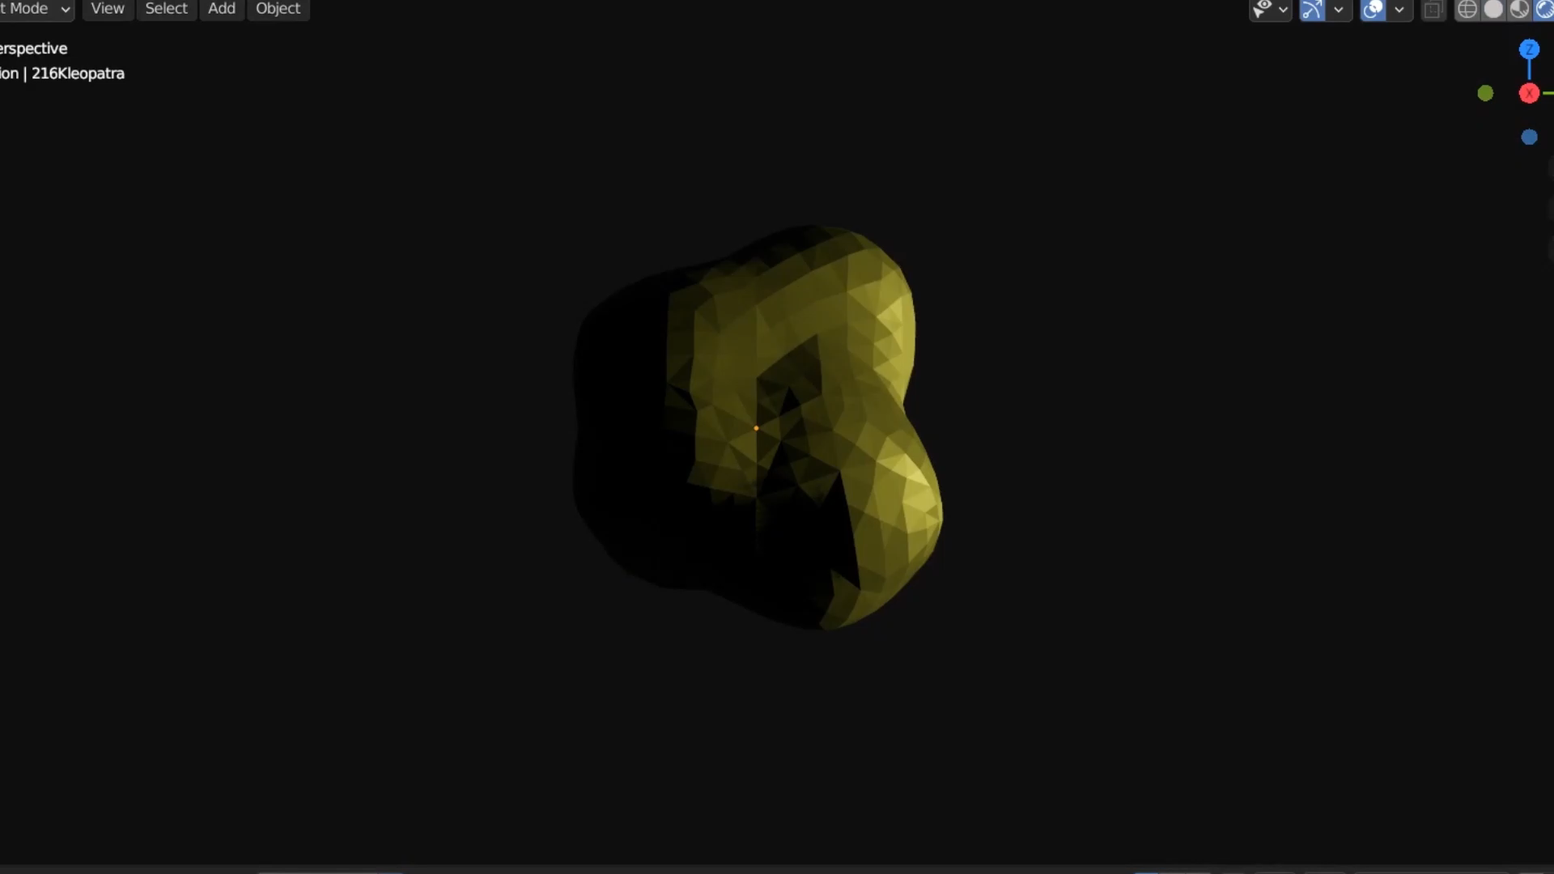
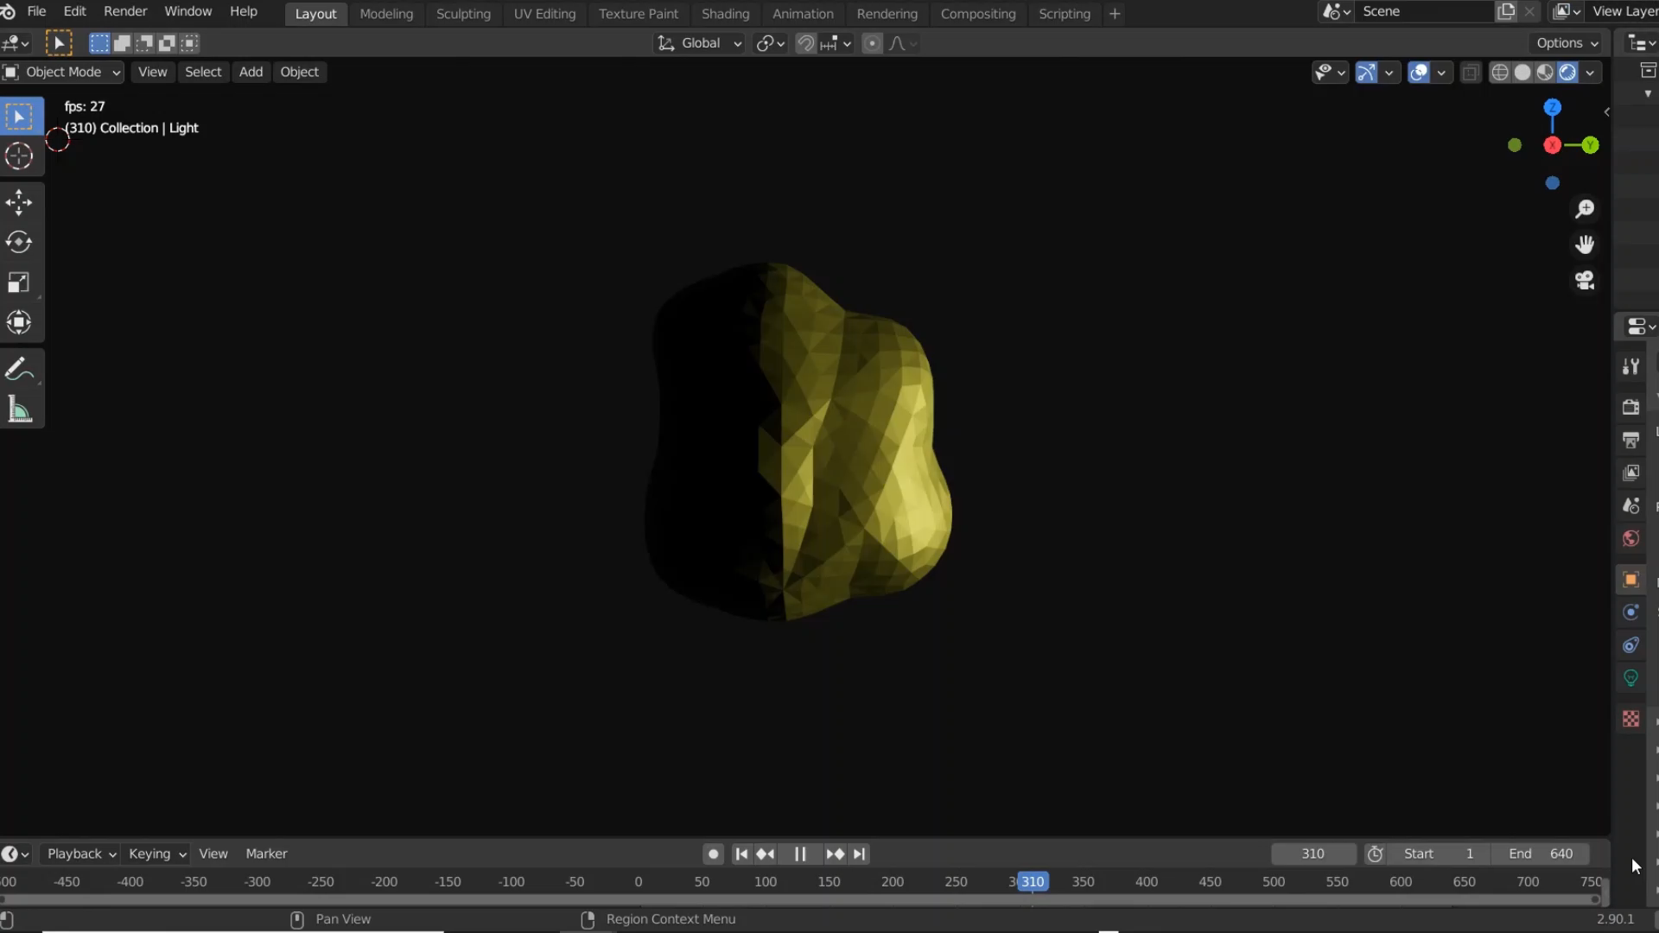
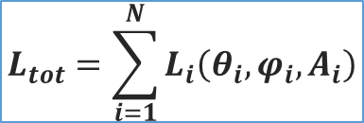
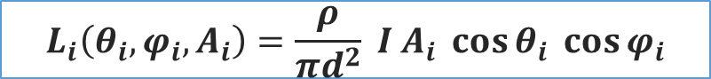
Scientific Background
$$L_{i}\left(θ_{i},φ_{i}, A_{i}\right)=\frac{ρ}{πd^{2}} Ι Α_{i} \cos{θ_{i}} \cos{φ_{i}}$$
$$L_{tot}=\sum_{i=1}^{N}{L_{i}\left(θ_{i},φ_{i},A_{i}\right)}$$

Slide 4

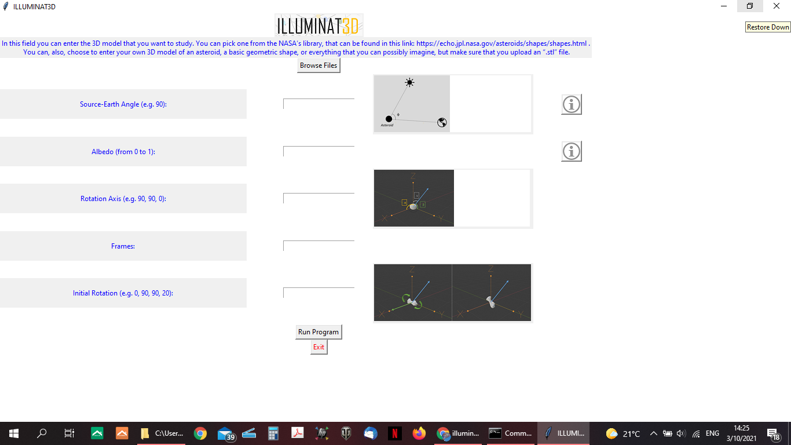
The G.U.I.
Clean,
user-friendly.
Five
parameters.
Explanatory images.
Educative information.

Slide 5

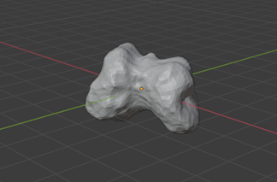
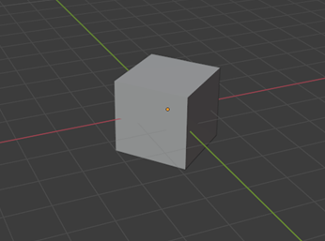
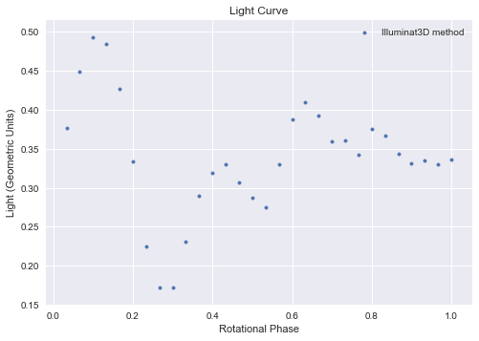
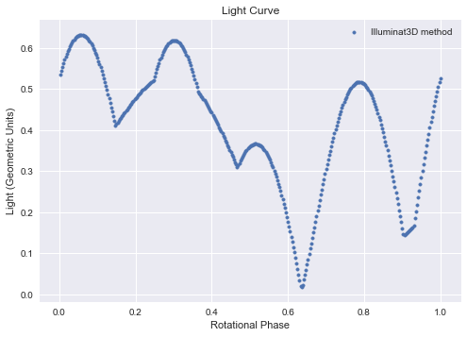
The Plots
Mirtha
Cube
Parameters: No initial rotation, Rotation axis: z, Albedo: 1, Source-Earth angle: 90 deg, Frames: 30.
Parameters: Initial rotation: random, Rotation axis: random, Albedo: 1, Source-Earth angle: 90 deg, Frames: 360.

Slide 6

Thoughts for the Future
Dealing with the reverse problem. We want to develop our app, so we are able to find the shape of an object, by analyzing its light curve.
More parameters will be added, i.e. the ability to analyze a black or grey body, the ability to upload more file types.
Upgrading the GUI, i.e. projection of the estimated time, visualization, design.
Dealing with the errors, that exist due to the use of the shapely library, i.e. contact a specialist, use a different library.

Slide 7
ILLUMINAT3D
THANK YOU, FOR YOUR ATTENTION!
NASA’S SPACE APPS CHALLENGE
2021|THESSALONIKI

